Slide 1

File Explorer System
SRM INSTITUTE OF SCIENCE AND TECHNOLOGY
COLLEGE OF ENGINEERING AND TECHNOLOGY
DEPARTMENT OF COMPUTING TECHNOLOGY
21CSC202J-Operating Systems , Mini-Project Presentation
Mohan Nagal : RA2211003011960
Abhilash Tyagi : RA2211003011964
Section : N2
Guide name and Designation: Mrs. Renuka Devi
Associate Professor

Slide 2
Table of contents
Objective
Problem Statement
Architecture/ Flow chart
Hardware/Software requirements
Implementation- Code snippet
Results- Screen Shots of Output
Conclusion

Slide 3
OBJECTIVE
The objective of the provided code is to create a simple file explorer with use of OS in C.
This file explorer aims to assist users in managing files and directories within their computer system.
It provides various file operations, including opening files, moving files to trash, creating directories, copying directories, duplicating files, renaming files, transferring files, importing files, displaying file information, searching for files, and sorting files.

Slide 4
Problem Statement
Create a user-friendly file explorer application that allows users to efficiently manage their files and directories. The application should have the following features and functionalities:
File Navigation: Users can browse through directories and view the files and subdirectories within the current working directory..
File Operations
Open.
Move to Trash
Create Directory.
Copy Directory.
Rename
Transfer
Import

Slide 5
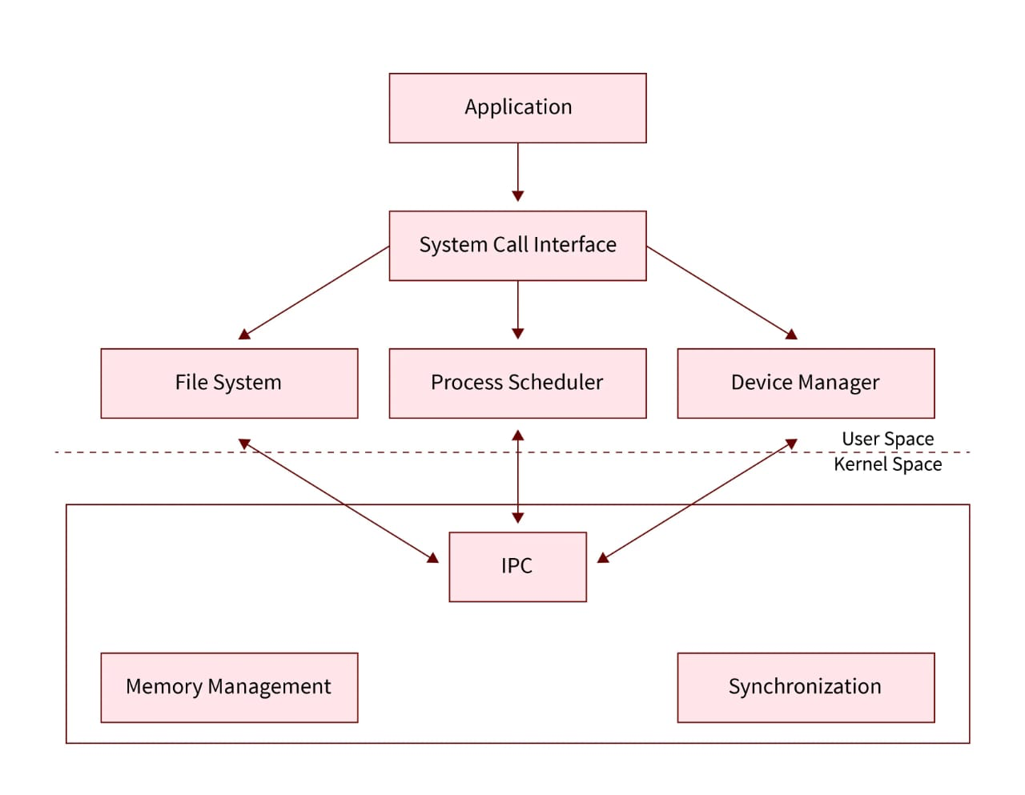
ARCHITECTURE FLOWCHART

Slide 6
Hardware/Software Requirements
Hardware :
Computer: Any modern personal computer should suffice. This code does not have particularly high hardware requirements.
Display: A monitor or screen with a resolution sufficient for displaying the graphical user interface.
Input Device: A standard keyboard and mouse or equivalent input devices.

Slide 7
C Compiler:You need a C compiler to compile and execute C code.
Integrated Development Environment (IDE) or Text Editor:While it's possible to write C code in a simple text editor and compile it using a command-line compiler, many developers prefer using an integrated development environment (IDE) or a code editor with C/C++ support.
Operating System:C code is platform-independent, which means you can write and compile C code on various operating systems, including Windows, macOS, and Linux.
Standard C Library:The standard C library provides essential functions and features.

Slide 8
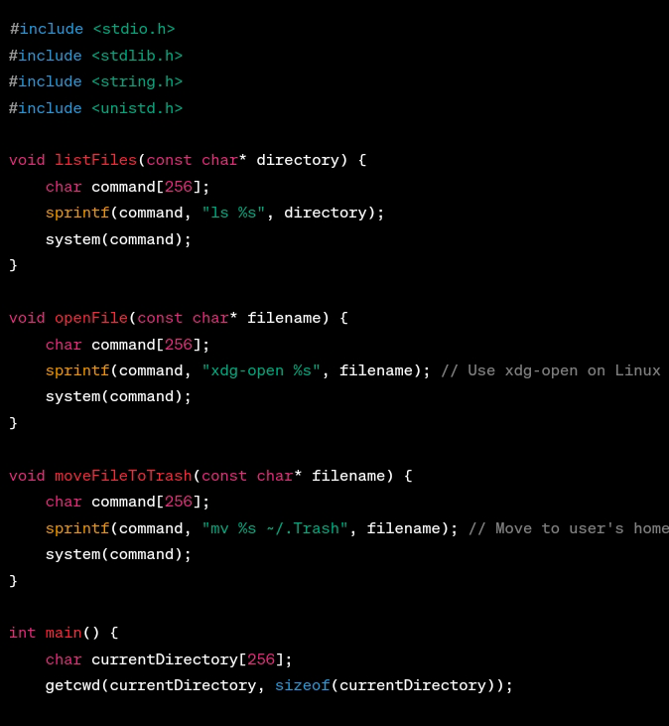
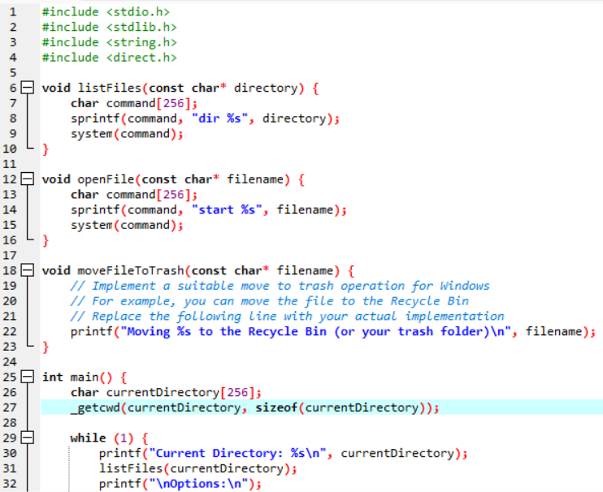
Code-Snippet

Slide 9
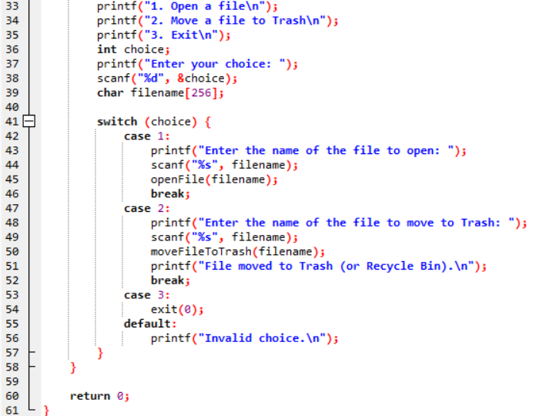
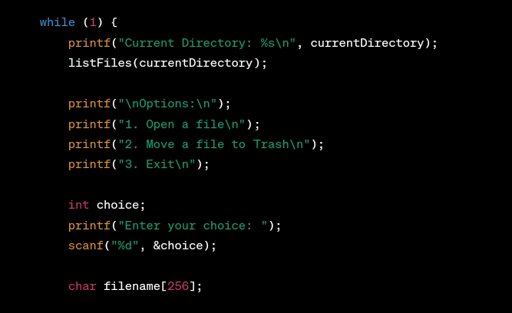

Slide 10
Implementations
The listFiles function takes the name of a directory as an argument.
It constructs a system command using the sprintf function to run the 'ls' command to list files and directories in the specified directory.

Slide 11
The openFile function takes the name of a file as an argument.
It constructs a system command to open the specified file using the 'xdg-open' command, which is commonly used on Linux to open files with the default application.
The moveFileToTrash function takes the name of a file as an argument. It constructs a system command to move the specified file to the user's home trash folder (typically /.Trash). The 'mv' command is used for this purpose. The system function executes the command.

Slide 12
In the main function, we initialize the program by getting the current working directory using the getcwd function and storing it in the currentDirectory variable. This information is used to display the current directory to the user.

Slide 13
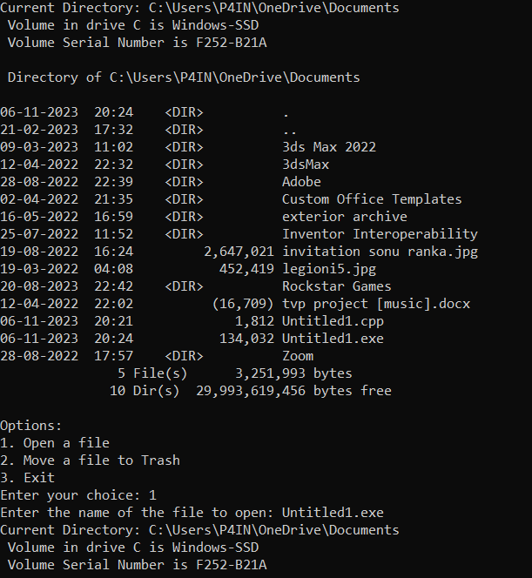
Output

Slide 14
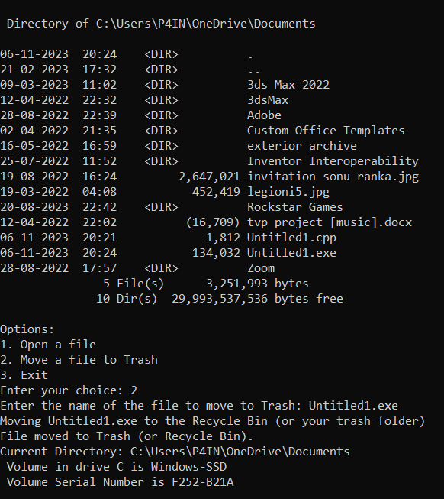

Slide 15
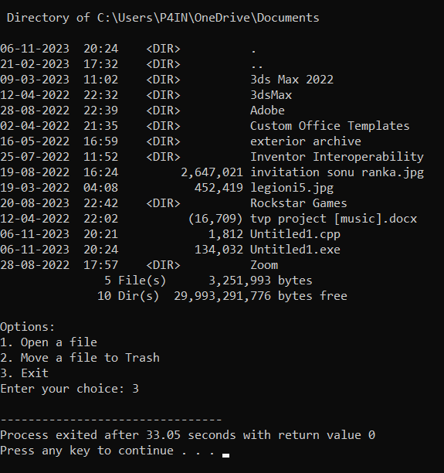

Slide 16
Thanks

